Slide 1
Spark in Azure
Matt Witman
Cloud Solution Architect
Advanced Analytics & AI
Matt.witman@Microsoft.com

Slide 2
Spark on Azure Options
HDInsight Spark
Azure Databricks
Spark on Azure Batch using Docker
https://azure.microsoft.com/en-us/blog/on-demand-spark-clusters-on-docker/
Spark IaaS ( Hortonworks, Cloudera, Mapr )

Slide 3
LOOKING ACROSS THE OFFERINGS
Azure HDInsight
What It Is
Hortonworks distribution as a first party service on Azure
Big Data engines support – Hadoop Projects, Hive on Tez, Hive LLAP, Spark, HBase, Storm, Kafka, R Server
Best-in-class developer tooling and Monitoring capabilities
Enterprise Features
VNET support (join existing VNETs)
Ranger support (Kerberos based Security)
Log Analytics via OMS
Orchestration via Azure Data Factory
Available in most Azure Regions (27) including Gov Cloud and Federal Clouds
Guidance
Customer needs Hadoop technologies other than, or in addition to Spark
Customer prefers Hortonworks Spark distribution to stay closer to OSS codebase and/or ‘Lift and Shift’ from on-premises deployments
Customer has specific project requirements that are only available on HDInsight
Azure Databricks
What It Is
Databricks’ Spark service as a first party service on Azure
Single engine for Batch, Streaming, ML and Graph
Best-in-class notebooks experience for optimal productivity and collaboration
Enterprise Features
Native Integration with Azure for Security via AAD (OAuth)
Optimized engine for better performance and scalability
RBAC for Notebooks and APIs
Auto-scaling and cluster termination capabilities
Native integration with SQL DW and other Azure services
Serverless pools for easier management of resources
Guidance
Customer needs the best option for Spark on Azure
Customer teams are comfortable with notebooks and Spark
Customers need Auto-scaling and
Customer needs to build integrated and performant data pipelines

Slide 4
Apache Spark Overview

Slide 5
Apache Spark
An unified, open source, parallel, data processing framework for Big Data Analytics
Spark SQL
Interactive Queries
Spark MLlib
Machine Learning
Spark Streaming
Stream processing
GraphX
Graph Computation
Spark Unifies:
Batch Processing
Interactive SQL
Real-time processing
Machine Learning
Deep Learning
Graph Processing
Spark Core Engine
Yarn
Mesos
Standalone Scheduler

Slide 6
Spark - Benefits
Performance
Using in-memory computing, Spark is considerably faster than Hadoop (100x in some tests).
Can be used for batch and real-time data processing.
Developer Productivity
Easy-to-use APIs for processing large datasets.
Includes 100+ operators for transforming.
Unified Engine
Integrated framework includes higher-level libraries for interactive SQL queries, Stream Analytics, ML and graph processing.
A single application can combine all types of processing.
Ecosystem
Spark has built-in support for many data sources, rich ecosystem of ISV applications and a large dev community.
Available on multiple public clouds (AWS, Google and Azure) and multiple on-premises distributors

Slide 7
Advantages of a Unified Platform
Input Streams of Events
Improves developer productivity—a single consistent set of APIs
All different systems in Spark share the same abstraction – RDDs (Resilient Distributed Datasets)
Developers can mix and match different kind of processing in the same application. This is a common requirement for many big data pipelines.
Performance improves because unnecessary movement of data across engines is eliminated. In many pipelines, data exchange between engines is the dominant cost
Spark Streaming
Spark Machine Learning
Spark SQL
NoSQL DB

Slide 8
Azure Databricks Spark
Databricks Spark as a managed service on Azure

Slide 9
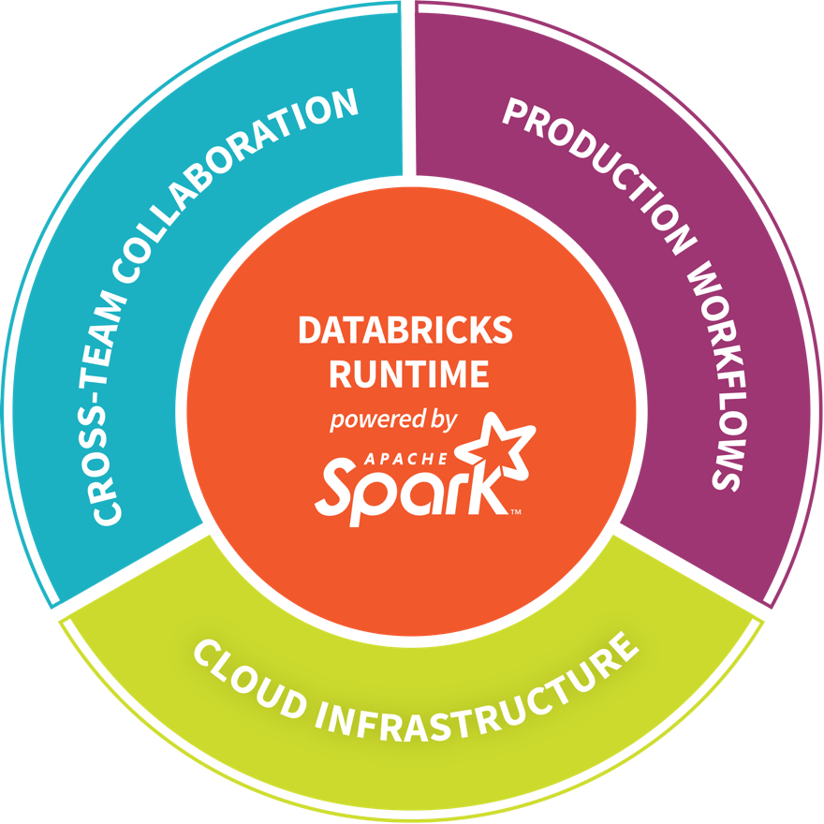
Databricks - Company Overview
Founded in late 2013
By the creators of Apache Spark, original team from UC Berkeley AMPLab
Largest code contributor code to Apache Spark
Level 2/3 support partnership with
Hortonworks
MapR
DataStax
Provides certifications such as Databricks Certified Application, Databricks Certified Distribution and Databricks Certified Developer
Main Product: The Unified Analytics Platform
In Oct 2017, introduced Databricks Delta (currently in private preview).

Slide 10

Azure Databricks
Azure Databricks is a first party service on Azure.
Unlike with other clouds, it is not an Azure Marketplace or a 3rd party hosted service.
Azure Databricks is integrated seamlessly with Azure services:
Azure Portal: Service an be launched directly from Azure Portal
Azure Storage Services: Directly access data in Azure Blob Storage and Azure Data Lake Store
Azure Active Directory: For user authentication, eliminating the need to maintain two separate sets of uses in Databricks and Azure.
Azure SQL DW and Azure Cosmos DB: Enables you to combine structured and unstructured data for analytics
Apache Kafka for HDInsight: Enables you to use Kafka as a streaming data source or sink
Azure Billing: You get a single bill from Azure
Azure Power BI: For rich data visualization
Eliminates need to create a separate account with Databricks.
Microsoft Azure

Slide 11



Azure Databricks
Azure Databricks
Collaborative Workspace
IoT / streaming data
Machine learning models
DATA ENGINEER
DATA SCIENTIST
BUSINESS ANALYST
Deploy Production Jobs & Workflows
Cloud storage
BI tools
MULTI-STAGE PIPELINES
JOB SCHEDULER
NOTIFICATION & LOGS
Data warehouses
Optimized Databricks Runtime Engine
Data exports
Hadoop storage
DATABRICKS I/O
APACHE SPARK
SERVERLESS
Rest APIs
Data warehouses
Enhance Productivity
Build on secure & trusted cloud
Scale without limits
Notes:
Databricks, founded by the team that created Apache Spark – unified analytics platform that accelerates innovation by unifying data science, engineering & business.
75% of the code committed to Apache Spark comes from Databricks
Unified Runtime
Create clusters in seconds, dynamically scale them up and down.
They’ve made enhancements to Spark engine to make it 10x faster than open source Spark
Serverless- Auto-configured multi-user cluster, Reliable sharing with fault isolation
Unified Collaboration
Overall – a simple & collaborative environment that enables your entire team to use Spark & interact with your data simultaneously
DE – Improve ETL performance, zero management clusters. Execute production code from within notebooks
DS - For data scientists, easy data exploration in notebooks
Business SME – interactive dashboards empower teams to create dynamic reports
Enterprise Security
Encryption
Fine grained Role-based access control (files, clusters, code, application, dashboard)
Compliance
Rest APIs
DE – DBIO, SPARK, API’s , JOBS
DS – Spark and Serverless, Interactive Data Science
Data Products - Everything
Creators of Spark
Training People
Number of Customers
Ingest
Workflow
Schedule / Run / Monitor
Execute
Troubleshoot
Debug
Production Jobs
---------
Ingest, ETL, Scheduling, Monitoring

